Slide 1


Large Scale Data Analytics: MapReduce vs. Spark
Presenter: arthurl3
Notes:
Hi, my name is Arthur and I’ll be presenting on the paper “Clash of the Titans: MapReduce vs. Spark for Large Scale Data Analytics”
I’ll start the presentation with 1) key ideas at a high-level; then start to dive 2) into the mid-level details related to the algorithms used, design, and tools; and 3) for one of the algorithms used, dive into the finer details related to the implementation.

Slide 2


Abstract
MapReduce and Spark – most popular open source cluster computing frameworks for large scale data analytics.
Both hide complexity of task parallelism and fault-tolerance
Detailed Analysis:
1) Correlate the task execution plan with the resource utilization
2) Break-down of the task execution time for in-depth analysis
Notes:
To jump into the meat of the paper, the abstract of this paper is to conduct a detailed of MR and Spark with two profiling tools for comparison. The two methods for these tools are 1 and 2

Slide 3
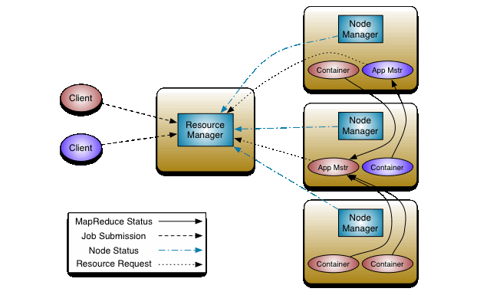
MapReduce
Earliest + best known
Apache Hadoop – widely used open source implementation
Simple, but framework limitations
Processes data iteratively = multiple rounds of computation on the same data
Designed mainly for batch jobs, but also used for iterative jobs.
Notes:
1.1 Cluster Computing Architectures
MapReduce is one of the earliest and best known frameworks. It follows the functional programming model, and performs explicit synchronization across computational stages. It also exposes a simple programming API in terms of map() and reduce() functions. Apache Hadoop is a widely used open source implementation. MR is simple and attractive for users, but the framework has limitations. For example, MR processes data iteratively which leads to multiple rounds of computation on the same data.

Slide 4
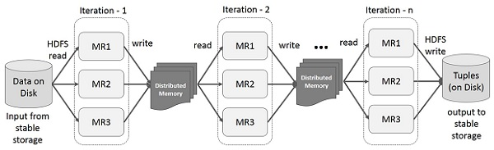
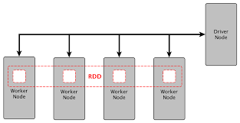
Spark
Resilient Distributed Datasets (RDDs) implement in-memory data structures to cache intermediate data across a set of nodes
Designed mainly for iterative jobs, but also used for batch jobs
Notes:
1.1 Cluster Computing Architectures
To overcome MapReduce’s limitation of iteratively processing data, Spark uses RDDs, which implement in-memory data structures to cache intermediate data across a set of nodes. Since RDDs can be kept in memory, algorithms can iterate over RDD data many times very efficiently.

Slide 5
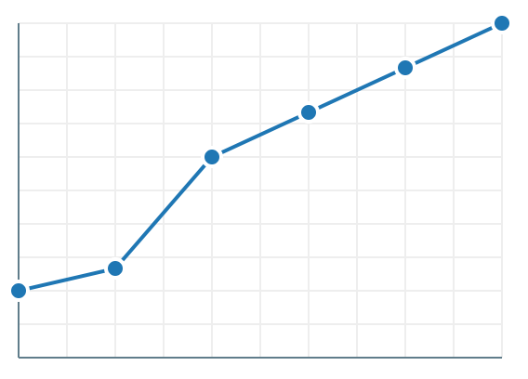
Profiling Tools
1) Visualize the correlation of the task execution plan with resource utilization
2) Break-down of the task execution time for in-depth analysis
Notes:
The authors used these two profiling tools to quantify the differences between the two frameworks

Slide 6

Contributions
1) State of the Art
Most popular frameworks for large scale data analytics.
2) Advances
Dissects MapReduce and Spark frameworks to collect stats to identify differences
Attribute performance differences to architectural components
Notes:
1.4 Contributions
Next I want to touch upon how the paper describes what the state of the art is and how the paper advances the state of the art.
Since MapReduce and Spark the most popular, they are the state of the art. This paper’s contributions with respect to related work is primarily on how this paper advances the two frameworks.
The paper advances the state of the art primarily by dissecting both frameworks to collect stats to identify differences in their shuffle components & using detailed analysis of the exeuction plan profiling tool to attribute performance differences in major architectural components for the two frameworks.

Slide 7
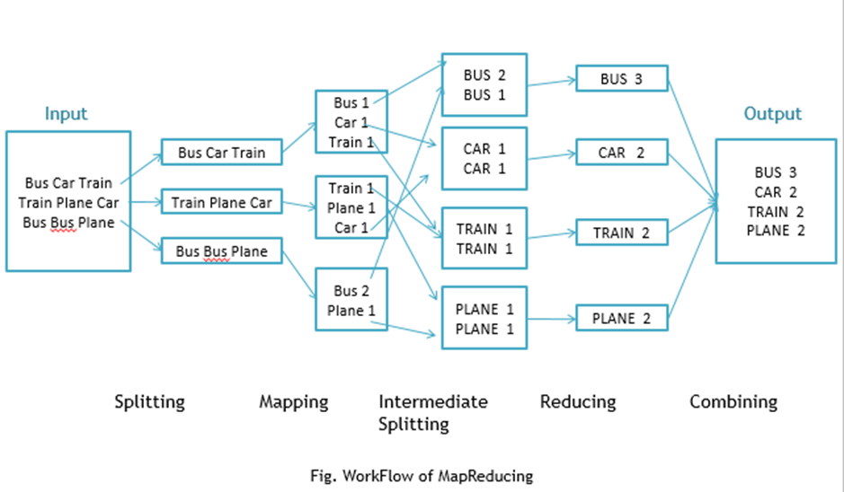
Workload Description
Set of Workloads:
Word Count (WC)
Sort
K-Means
Linear Regression (LR)
PageRank
Notes:
Now to go over the algorithms that the authors used for their comparisons, they identified a set of 5 important analytic workloads: Word Count (WC), Sort, K-means, linear regression (LR), PageRank.
These runs would cover typical characteristics of batch and iterative analytic application runs.
For this experiment, they did one-pass and iterative jobs. For each job, they covered different shuffle selectivity, job selectivity, and iterative selectivity.

Slide 8
Deep Dive: Experiment Setup
Hardware Same hardware; 4 total servers. Each node has 32x 2.9GHz, CPU cores 9 disk drives at 7.2k RPM with 1 TB each 190 GB of RAM Total: 128 CPU cores, 760 GB RAM, and 36 TB locally attached storage. Read Speed: 125GB/sec Write Speed : 45GB/sec Equivalent to a cluster with 100 VMs | Software Hadoop v2.4.0, YARN 32 Containers Per node JVM heap size 3GB per task Spark v1.3.0 in standalone on HDFS v2.4.0 Each node has 8 Spark workers with 4 threads JVM heap size 16GB for both Spark driver and executors
Notes:
Now we're going to deep dive into the implementation and algorithm details of the experiment. To give you an idea of the setup, both clusters were deployed on the same hardware with a total of four servers. They used the following hard and software configurations.

Slide 9
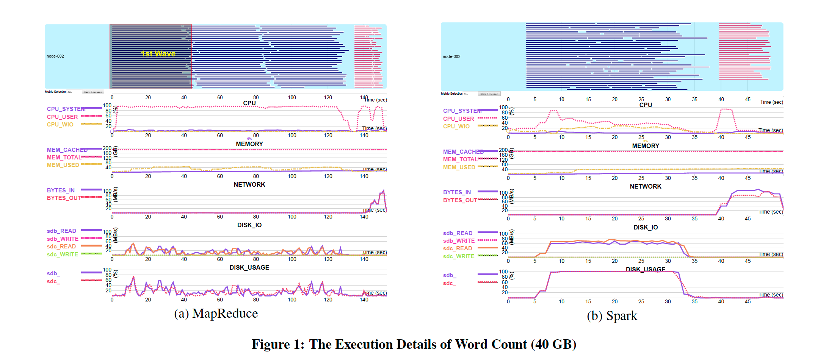
Deep Dive: WordCount
3 Waves of Map tasks (Blue Fig 1)
Map Stage:
Spark: Disk-bound
MR: CPU-bound
Spark requires less CPU time
Reduce Stage:
Network resource utilization is network-bound
Notes:
Now I'd like to deep dive into one of the algorithms used by the authors for comparison, WordCount. The attached image shows the execution details for WC split by MR and Spark. At the top left for MR, you can see three clearly waves of Map tasks while on the Spark side, there are no clearly defined waves. In addition, if you look closely at the Time in seconds, you'll see that Spark is faster than MR. This aligns with what the authors found, that Spark is 3x faster than MR in the map stage. Since the application logic and the amount of intermediate data is similar, they concluded the difference is due to the aggregation component. Spark is disk-bound and requires less CPU time while MR is CPU-bound. In the reduce stage, the authors received similar results and identified that network resource utilization is network-bound.

Slide 10
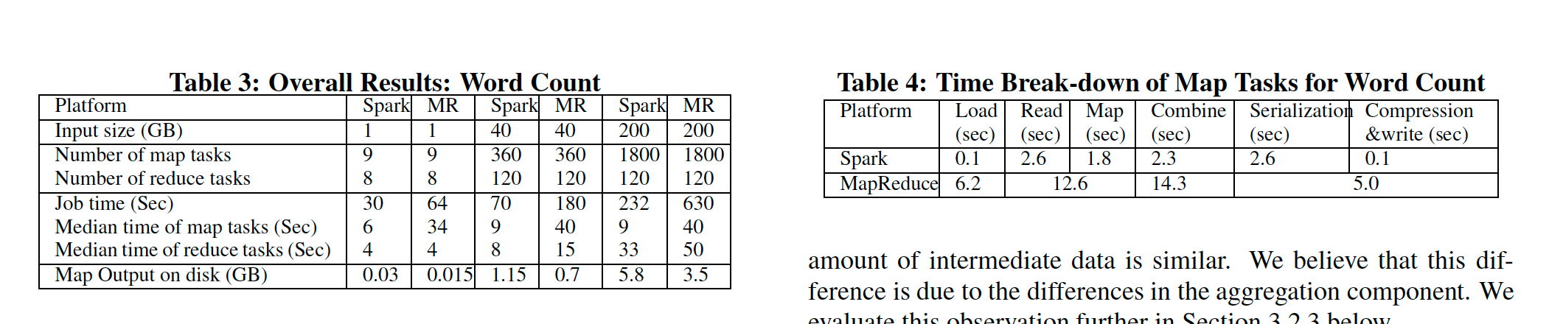
Deep Dive: WordCount Part 2
The shuffle selectivity in WC can be significantly reduced using a map side combiner.
Hash-based aggregation in Spark is more efficient than sort-based aggregation in MR.
Due to complexity differences in in-memory collection and combine components.
Notes:
To see how the authors used their second profiling tool, here's the authors' table break-down of the task execution times. From this table, they concluded that, for WC and similar workloads, the shuffle selectivity can be significantly reduced by using a map side combiner (Spark). For these types of workloads, hash-based aggregation in Spark is more efficient than sort-based aggregation in MapReduce because Spark has lower complexity in its in-memory collection and combine components.

Slide 11
Results Summary Part 1
Word Count:
Recall: Hash-based aggregation in Spark is more efficient than sort-based aggregation in MapReduce.
Sort
1) MR’s reduce stage is faster than Spark because MR can overlap the shuffle stage with the map stage, hiding network overhead.
2) Spark’s execution time of the map stages increases as the number of the reduce tasks increase.
3) For both, the reduction of disk spills during the shuffle stage may not lead to the speed-up since disk I/O is not a bottleneck.
Notes:
Now that we dove deep into one of the algorithms. In the interest of time, I'll take us back up to the high-level overview and share the results of the other analytics workloads the authors ran tests for.

Slide 12
Results Summary Part 2
Iterative Algos: K-Means and LR
Caching the raw file to reduce disk I/O may not help reduce execution time
RDD caching can reduce disk I/O and CPU overhead.
The hit ratio of both OS buffer cache and HDFS caching can increase from one iteration to the next.
PageRank
1) Spark can avoid materializing graph data structures on HDFS across iterations, which reduces various overheads.
2) In Graph-X, the CPU overhead for serialization/de-serialization may be higher than the disk I/O overhead without serialization.
Notes:
For the results of our other workloads. For iterative algorithms like K--Means and Linear Regression
If an iteration is CPU-bound, caching the raw file to reduce disk I/O may not help reduce the execution time since the disk I/O is hidden by the CPU overhead.
RDD caching can reduce disk I/O and CPU overhead since it can cache any intermediate data during the analytic pipeline
If OS buffer is sufficient, the hit ratio of both OS buffer cache and HDFS caching for the training data set increases from one iteration to the next iteration, because of the replica locality from previous iterations
PageRank
Compared to MapReduce, Spark can avoid materializing graph data structures on HDFS across iterations, which reduces overheads for serialization/de-serialization, disk I/O, and network I/O.
In Graph-X, the CPU overhead for serialization/de-serialization may be higher than the disk I/O overhead without serialization

Slide 13
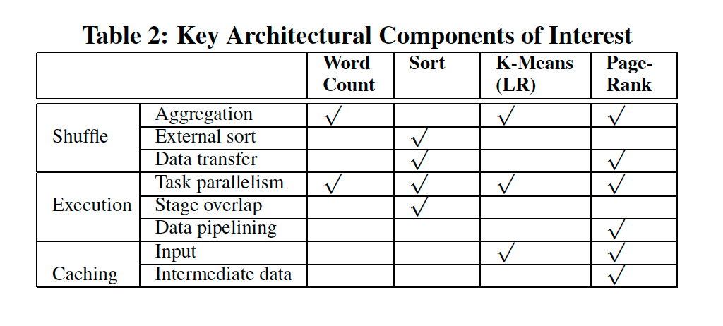
Cluster Configuration Impact
Measure performance impact of two parameters
Number of disks
Disk I/O for intermediate data is not a bottleneck for most workloads
At extremely unbalanced configs, disk I/O becomes a bottleneck
JVM heap size
Generally fraction of GC time decreases as the JVM heap size increases
When JVM heap size is larger than 256 MB, the fraction of GC time becomes relatively stable
The execution time is not sensitive to additional data spills to disks since disk I/O is not a bottleneck for WC and Sort.
Notes:
Our authors summarized the cluster configuration impact by measuring performance impact of two parameters: number of disks and JVM heap size.
Number of Disks
Disk I/O for intermediate data is not a bottleneck for typical cluster configurations, for a majority of MapReduce and Spark workloads.
At extremely unbalanced configs, disk I/O becomes a bottleneck
JVM
1) The fraction of GC time decreases as the JVM heap size increases, except for the reduce stage for Spark-Sort with 4 GB heap size per
task. This is caused by the additional overhead for OS page swapping.
2) When the JVM heap size is larger than 256 MB, the fraction of GC time becomes relatively stable;
3) The execution time is not sensitive to additional data spills to disks since disk I/O is not a bottleneck for WC and Sort.

Slide 14

Takeaways:
Spark is faster than MapReduce
2:5x for Word Count
5x for k-means
5x for PageRank
Primary Causes:
Hash-based is more efficient than sort-based in the above workloads
Caching input as RDDs can reduce CPU and disk overheads
Spark avoids materialization overhead
MapReduce is faster than Spark
2x for Sort
Can overlap the shuffle and map stage
Notes:
Now to move onto the findings of the paper and the key takeaways:
In many of the workloads, Spark is faster than MapReduce. 2 to 5x for WC, 5x for K-means, and 5x for PageRank. This is due to three primary causes:
1) For Word Count and similar workloads, where the map output selectivity can be significantly reduced using a map side combiner, hash-based aggregation in Spark is more efficient than sort-based aggregation in MapReduce. The execution time break-down result indicates that the hash-based framework contributes to about 39% of the overall improvement for Spark
2) For iterative algorithms such as kmeans and PageRank, caching the input as RDDs can reduce both CPU and disk I/O overheads for subsequent iterations.
3) Since Spark enables data pipelining within a stage, it avoids materialization overhead for output data on HDFS among iterations for graph analytics algorithms such as PageRank.
The exception is for Sort, where MR is 2x faster than sort. An exception to Spark’s performance advantage over MapReduce is the Sort workload, for which MapReduce is 2x faster than Spark. This is due to differences in task execution plans. MapReduce can overlap the shuffle stage with the map stage, which effectively hides network overhead which is often a bottleneck for the reduce stage.

Slide 15
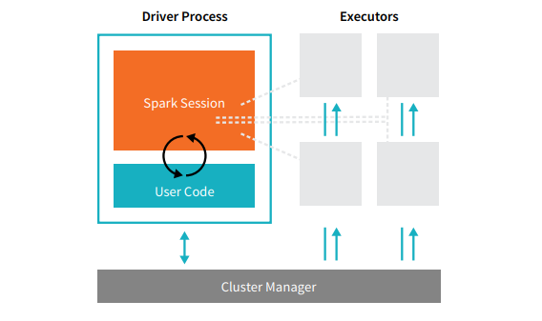
Observations: Architectural and Implementation Differences
In current Spark versions, an executor is now scalable to many reduce tasks, enabling Spark’s thread-based model to outperform MapReduce’s process-based model.
Both are now scalable to run many tasks during a shuffle, but Spark’s model eliminates the context switching overhead among JVM processes in MapReduce
MapReduce is more than 10x slower than Spark for task loading.
Notes:
Our authors also included some observations about architectural and implementation differences between the two frameworks after they concluded their key takeaways.

Slide 16
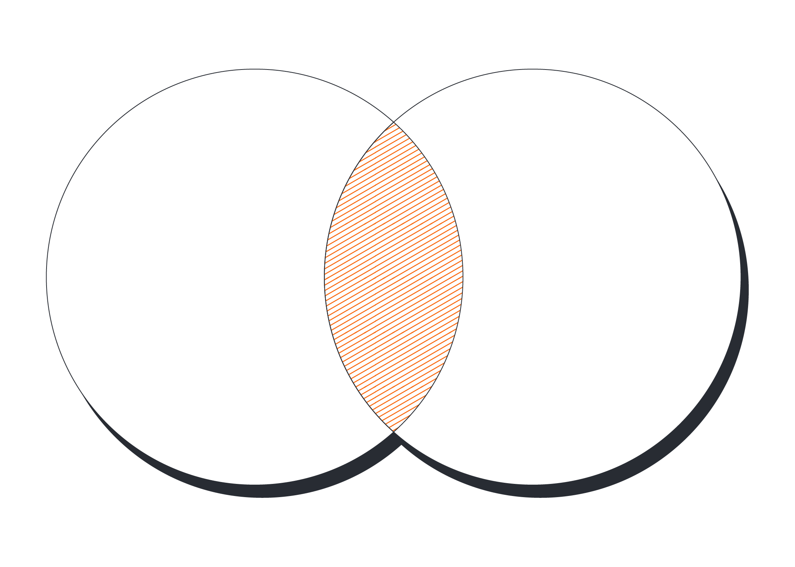
Common Characteristics
For one pass jobs like WC and Sort,
the map stage is often CPU-bound, and
the reduce stage is often network-bound
For typical machine learning (k-means, LR) and graph analytics algorithms like PageRank,
parsing text to objects is often the bottleneck for each iteration
Notes:
They also included observations about common characteristics.

Slide 17
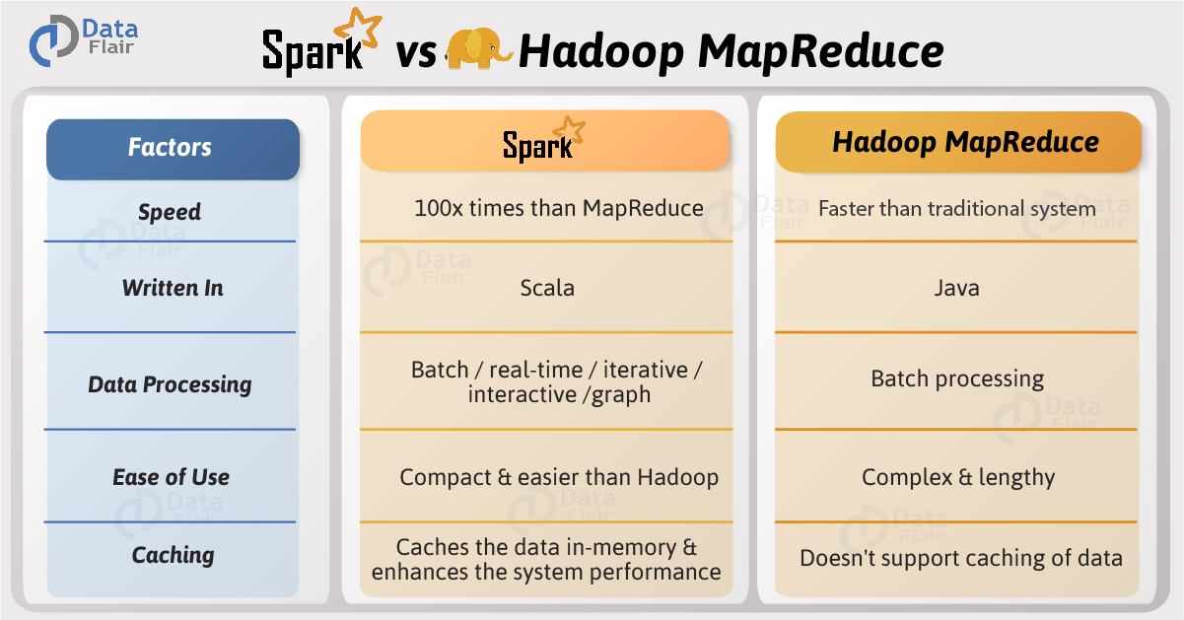
Critique
Pros:
Well structured
Methodical experiment
Many Factors considered
Depth of analysis
Well thought conclusions
Cons:
Given number of other popular open source tools, comparing just two seemed to fall short
Potential New Directions:
Different frameworks and analytic tools, like Storm
More workloads and common algorithms
Notes:
To include a critique of the paper, I'd like to share the pros/cons and some new directions I had thought of while reading it:
Pros of the paper’s key ideas, approach, and algorithm/design; It was well structured, methodical approach to its experiment, considered multiple factors, had deep analysis, and well thought conclusions.
Cons of the paper’s key ideas, approach, and algorithm/design; Given the number of the other popular open source tools, comparing just two seemed to fall short.
While leads to my third point, where two directions where this paper can expand upon is to 1) Inclusion of other different frameworks and analytics tools, like Storm and 2) incorporate more workloads to get a wider range of reference points.

Slide 18
Fin
Notes:
And that concludes my presentation. Thank you for listening and watching. I hope you enjoyed it and learned something new.

